Slide 1



North South University
#HackToTheFuture

Slide 2
Team: 3 Pixels
Name: Aporbo Ghosh
ID: 1931458042
Name: Ayesha Rahman
ID: 1931209042
Name: Sabrina Akter Sabina
ID: 1931947042

Slide 3
Lack of home medical support (home doctor, nursing service, physician, etc
Shortage of medicine and doesn’t know the ambulance are free or not
Failing in maintaining distance for overfill the health centers
Problems
Not getting the test reports on time
Lack of information (seats available in hospitals and contacts )

Slide 4


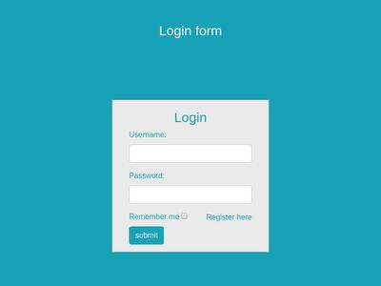
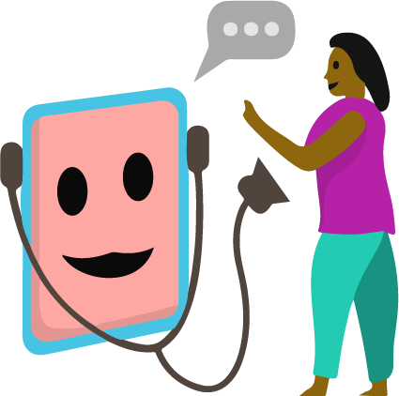

Solution And Features
Doctors can login with his bio
Nurses can login for home service
Patient can take appointments and can interact virtually with doctor
Patients can login for take services
Reminder can help patients to attend doctors

Slide 5
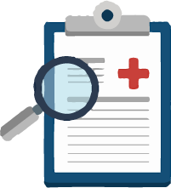
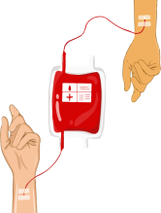


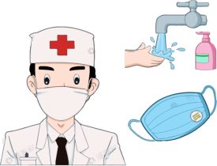
User can register for test according to their want and see all the fees. They can test from home as many of the test are available
User can contact the blood bank urgently and contact nearby hospitals
Nurse at Home
Patients can get home services like home doctors, nurse service, physicians etc along with their detailed information with 100% security assurance
Here user can view health tips and can get help by seeing the health tips that the doctors uploaded in the website

Slide 6
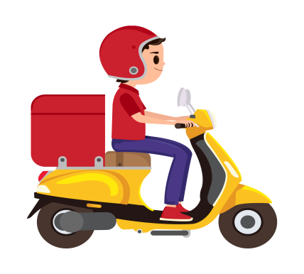
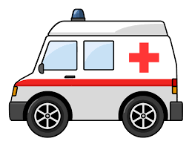
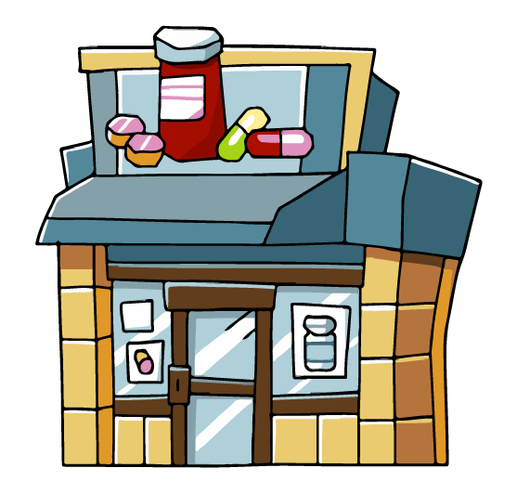
User can call for ambulance in the appointed number if they want and can see all the types available ambulances with their reaching time
For patient user can order food as his/her doctor prescribed and see the categories of food. User can include their demands in the description bar and mention the patient current condition
User can buy their required medicine seeing full description written here just like online oder

Slide 7
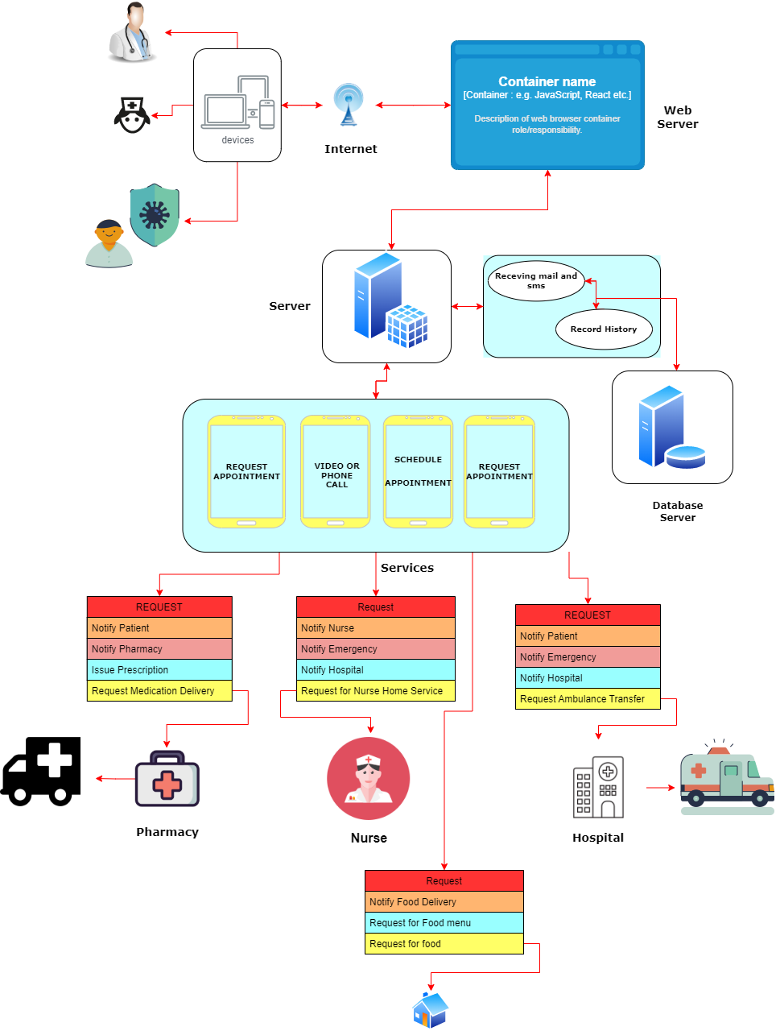
System Architecture of Solution

Slide 8
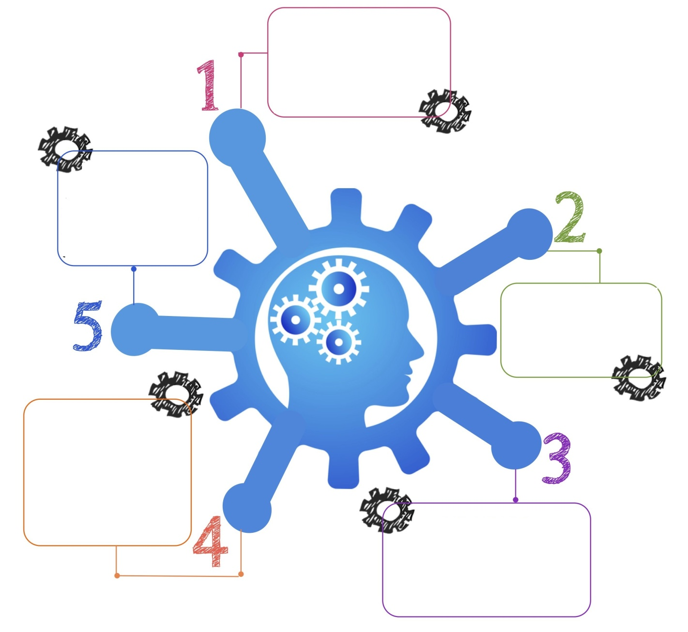
Why TeleMedic
Doctors are on digital devices
Get more specific information
Get reports on time
Get nurses and food with doctor requirements at home
Worldwide doctors can access

Slide 9
Impact
Increase appointment bookings and capture patient demand 24/7. Time efficiency and access to the best health care service can make people's life easier.
Reaching out to the rural areas with abundant health services must be a significant concern.
International consults and suggestions are available in case of people's requirements and needs. From the rural area of the country connectivity with the all over the world, services and assistance can be provided for the sake of wellness program.

Slide 10
Conclusion
TeleMedic is such a platform that will help people in every aspect of health issues frequently with less struggle. The absolute purpose of the website is to give outstanding services in tough times and assist people in nourishing health care necessities.

Slide 11
Thank you

